Slide 1
Chapter 2 Properties of Real Numbers
VOCABULARY

Slide 2
Absolute Value
The distance from zero on the number line and the point representing a real number on the number line

Slide 3
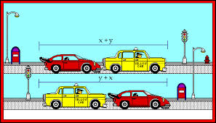
Commutative Property
Order changes
Ex.) 6+4 = 4+6

Slide 4
Associative Property
Grouping Changes
Ex.) (5+6) + 2 = 5+(6+2)

Slide 5
Identity Property
Sum of a number and 0
Ex.) -4 + 0 = -4

Slide 6
Inverse Property
Sum of a number and it’s opposite
Ex.) 5 + (-5) = 0

Slide 7
Reciprocals
2 number’s are reciprocals if their product is 1
Ex.) $\frac{3}{4}$ and $\frac{4}{3}$

Slide 8
Quotient
The answer to a division problem
$\frac{12}{4}$ = 3
Quotient

Slide 9
Product
The answer to a multiplication problem
Ex.) $4 ∙10=40$
Product

Slide 10
Coefficient
The number in front of a variable, usually a constant that is multiplied by a variable in a term
Ex.) 2x
Coefficient

Slide 11
Constant
A term or expression with no variable in it. It has the same value all the time.
Ex.) 2x + 8 = 67
Constants

Slide 12
Like Terms
Terms that have the same variables with each variable raised to the same power
Ex.) 2x + 8x = 16
Like Terms

Slide 13
Integer
Any whole number positive or negative.
Ex.) -7

